Slide 1
MIANGO-UJAH MADAKI’S DATA VISUALIZATION & OBSERVATIONS.

Slide 2
UNIVARIATE ANALYSIS.

Slide 3
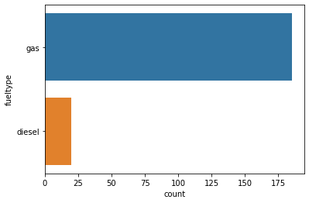
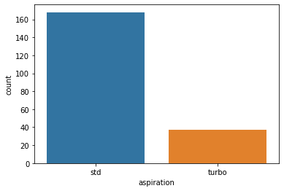
FIGURE 1 & 2
Univariate analysis for fuel type.
Univariate analysis for aspiration.

Slide 4
OBSERVATIONS FOR FIGURE 1 & 2
Most of the cars use gas
Most of the cars have naturally
aspirated engines

Slide 5
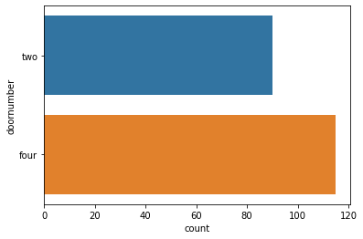
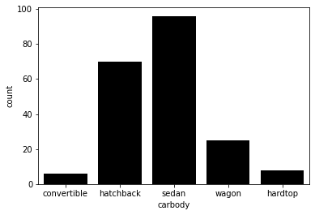
FIGURE 3 & 4
Univariate analysis for door number.
Univariate analysis for car body

Slide 6
OBSERVATIONS FOR FIGURE 3 & 4
Most of the cars have 4 doors
The cars with the highest distribution are of sedan type, while the lowest distribution are convertible.

Slide 7
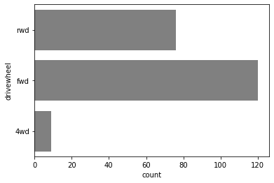
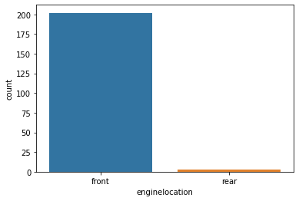
FIGURE 5 & 6
Univariate analysis for drive wheel.
Univariate analysis for engine location.

Slide 8
OBSERVATIONS FOR FIGURE 5 & 6
Most for the cars are front-wheel drives, while the lowest are four-wheel drives
Most of the cars have their engines located at the front.

Slide 9
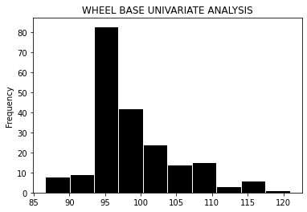
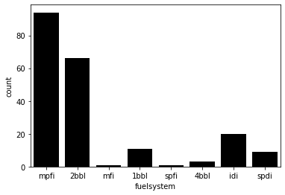
FIGURE 7 & 8
Univariate analysis for wheel base.
Univariate analysis for fuel system.

Slide 10
OBSERVATION FOR FIGURE 7 & 8
Most of the cars have the wheelbase is from 95mm, while the lowest wheelbase distribution is from 85mm
Most of the cars use Multi-point fuel injection
system.

Slide 11
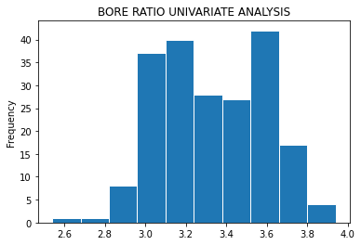
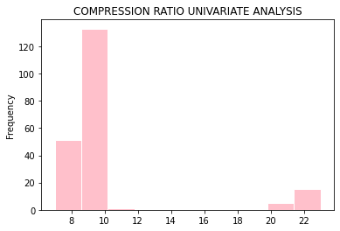
FIGURE 9 & 10
Univariate analysis for bore ratio.
Univariate analysis for compression ratio.

Slide 12
OBSERVATIONS FOR FIGURE 9 & 10
Most of the cars have a bore ratio of 3.6
Most of the cars have a petrol engine compression ratio of 10

Slide 13
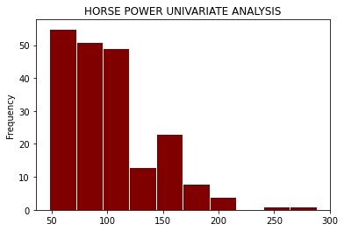
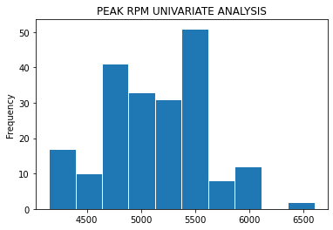
FIGURE 11 & 12
Univariate analysis for horse power
Univariate analysis for peak rpm

Slide 14
OBSERVATIONS FOR FIGURE 11 & 12
Most of the cars have horsepower between the range of 50-99
Most of the cars have a peak rpm of 5500

Slide 15
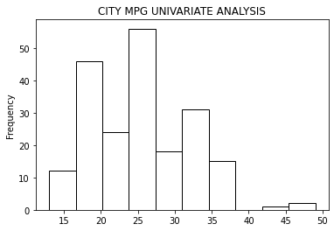
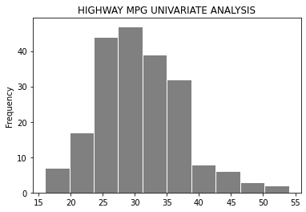
FIGURE 13 & 14
Univariate analysis for city mpg
Univariate analysis for highway mpg

Slide 16
BIVARIATE ANALYSIS

Slide 17
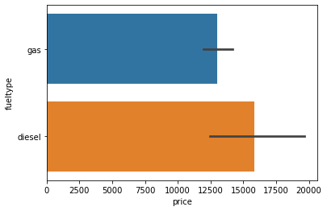
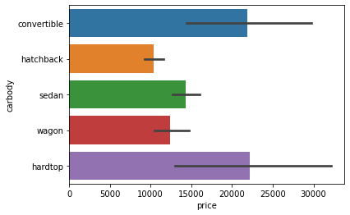
FIGURE 15 & 16
Bivariate analysis for fuel type & price
Bivariate analysis for car body & price

Slide 18
OBSERVATIONS FOR FIGURE 15 & 16
Cars that use diesel have a higher price than those that use gas
Convertible cars and hardtop cars have the highest prices, while hatchback cars have the lowest price

Slide 19
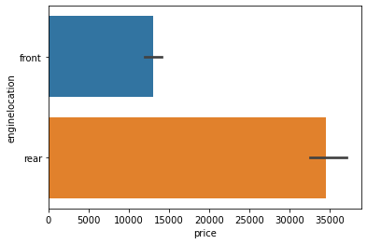
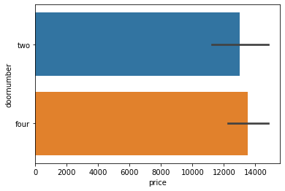
FIGURE 17 & 18
Bivariate analysis for engine location & price
Bivariate analysis for door number & price

Slide 20
OBSERVATIONS FOR FIGURE 17 & 18
Cars with rear engines have a higher price than those with front engines
Cars with 4 doors have a higher price than those with 2 doors

Slide 21
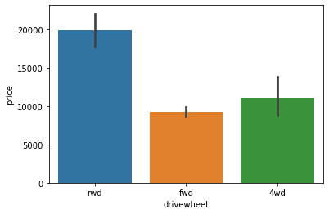
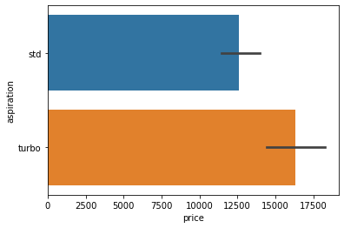
FIGURE 19 & 20
Bivariate analysis for drive wheel & price
Bivariate analysis for aspiration & price

Slide 22
OBSERVATIONS FOR FIGURE 19 & 20
Cars with four-wheel drives have higher prices.
Cars with turbo engines have a higher price than those with naturally aspirated engines

Slide 23
MULTIVARIATE ANALYSIS

Slide 24
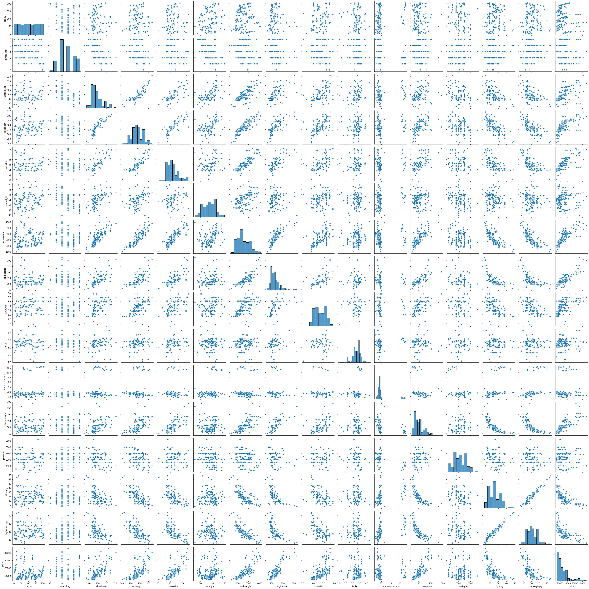
FIGURE 21
Multivariate analysis for cp data set.

Slide 25
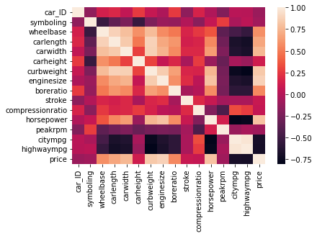
FIGURE 22
Multivariate analysis for cp data set.

